Slide 1


Note: The data and information in this document is reflective of a hypothetical situation and client. This document is to be used for KPMG Virtual Internship purposes only.
Sprocket Central Pvt Ltd
Data analytics approach
Nayan Srivastava

Slide 2
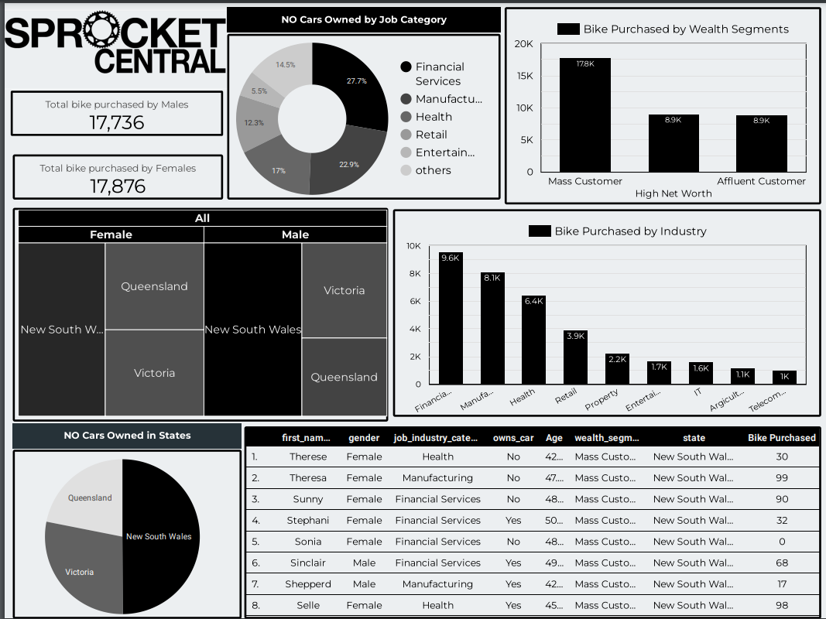
Note: The data and information in this document is reflective of a hypothetical situation and client. This document is to be used for KPMG Virtual Internship purposes only.
Dashboard Overview
:

Slide 3
Note: The data and information in this document is reflective of a hypothetical situation and client. This document is to be used for KPMG Virtual Internship purposes only.
Components of dashboard :
:
Interactive Dashboard includes various visuals which Includes :
No. of bike purchased by Gender Categorization i.e. Male and Female.
Target customers from New Customer List based on insights generated from task 2 .
Bike Purchased distribution by Job Industry categories.
Bike Purchased distribution by Wealth Segment .
Customer distribution by States.
Weak regions of cars owned over different Job Industry Categories and States.

Slide 4
Note: The data and information in this document is reflective of a hypothetical situation and client. This document is to be used for KPMG Virtual Internship purposes only.
Dashboard Description :
Target Customer Identification from New Customer List based on insights generated from task 2.
Target Customers are being identified by using model formulated in task 2 which contains applying filters over some specific fields i.e.
Age Clusters filter : Insights reflect that Customer in age clusters 42 – 52 years are the ones generating highest profit among all others.
Cars Owned over States Filter : Insights reflect that customers in New South Wales has the highest weightage in cars owned .
Job Industries Filter : Insights reflect that job categories Financial Services, Health and Manufacturing has the highest profit friendly customers with top3 bike purchased for the company .
Wealth segment Filter : Insights reflect that Mass Customers segment can be the highly focused customers segment for the company .

Slide 5
Note: The data and information in this document is reflective of a hypothetical situation and client. This document is to be used for KPMG Virtual Internship purposes only.
Outcomes :
On the basis of insights and filtered visualization, we can conclude that Customers with Age clusters 42 – 52 years living in New South Wales lying in Mass Customers wealth segment from the major job industry categories i.e. Manufacturing, Health and Financial Services can be our target and focused customers.
It funnelised our list of 1000 New Customers to most 38 valuable customers .

Slide 6
Note: The data and information in this document is reflective of a hypothetical situation and client. This document is to be used for KPMG Virtual Internship purposes only.
Appendix :
THANK YOU

